Slide 1


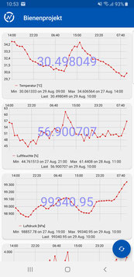
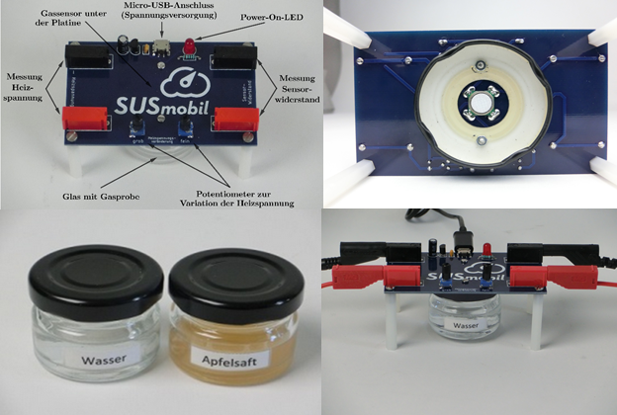
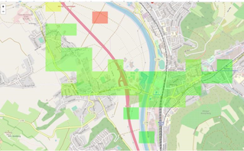
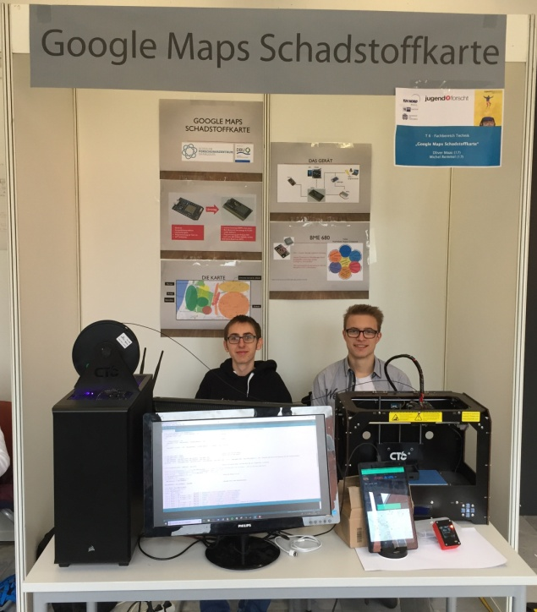
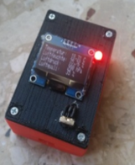
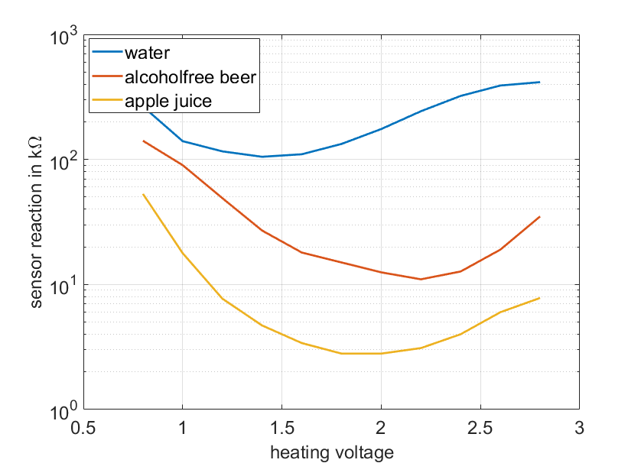
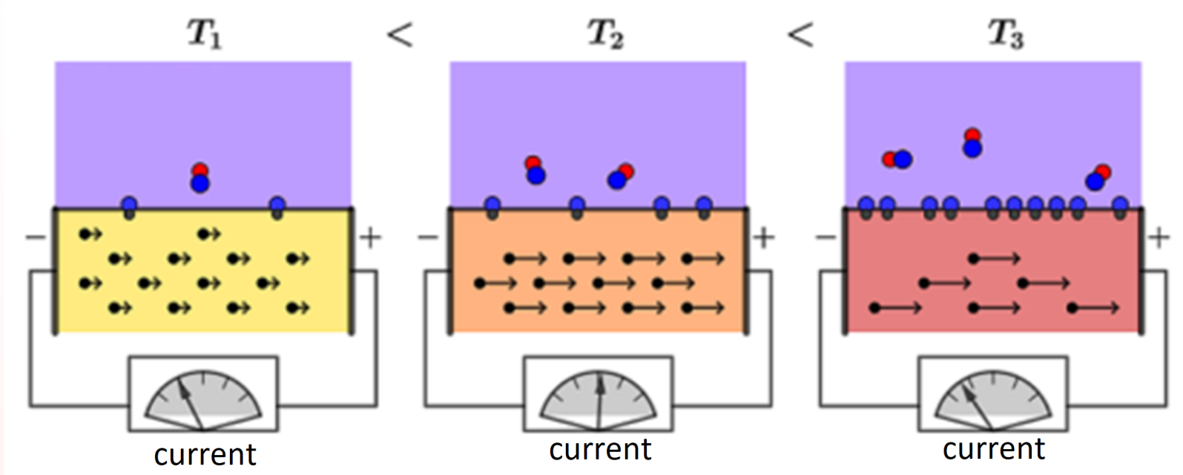
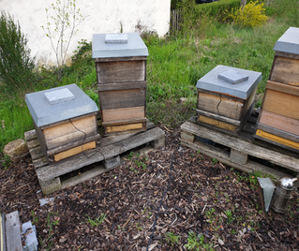
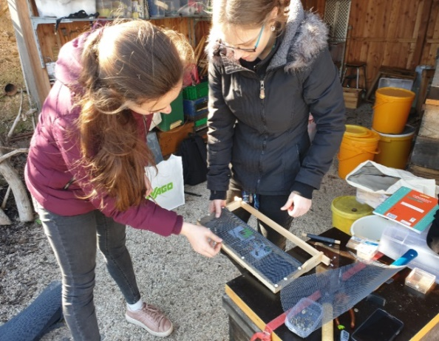
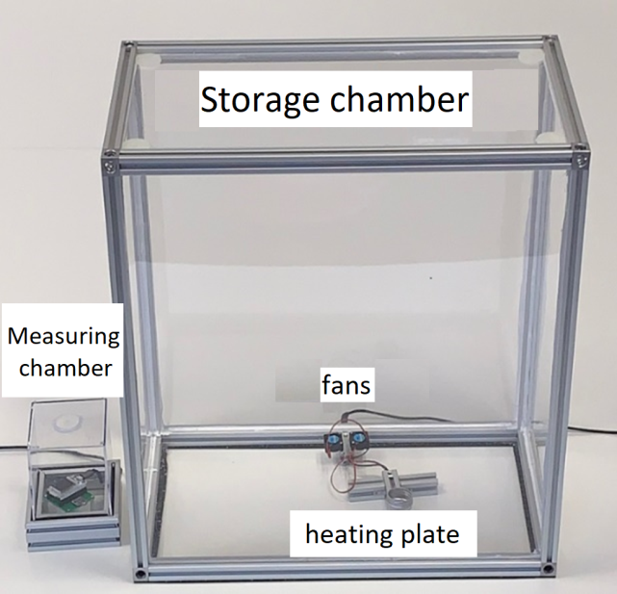
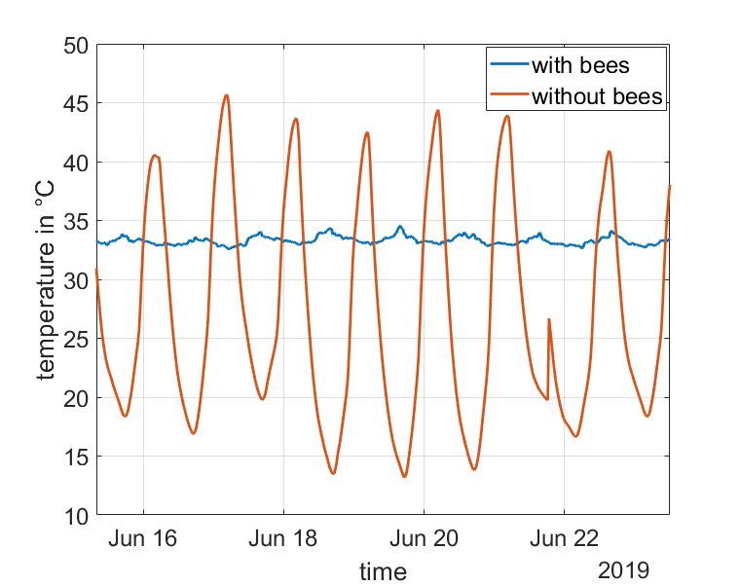
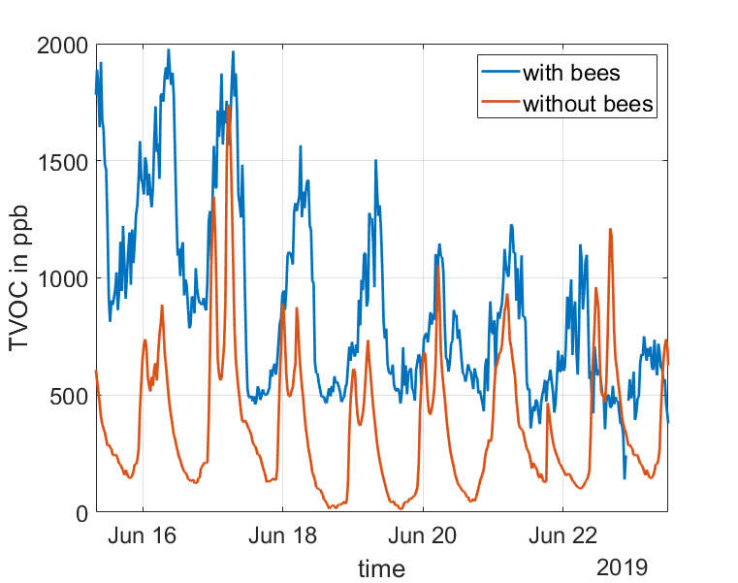
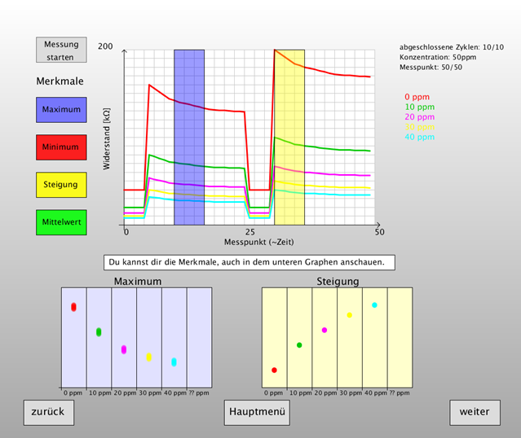
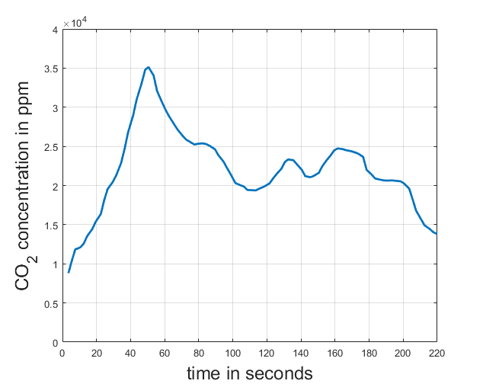
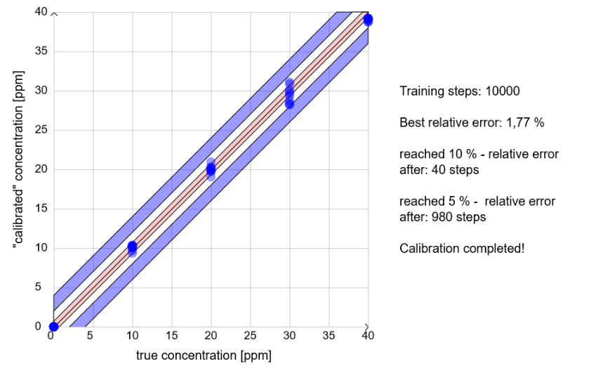
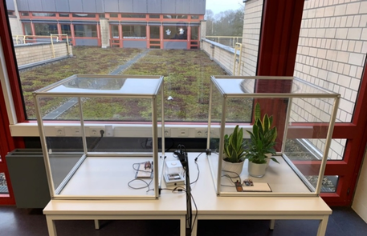
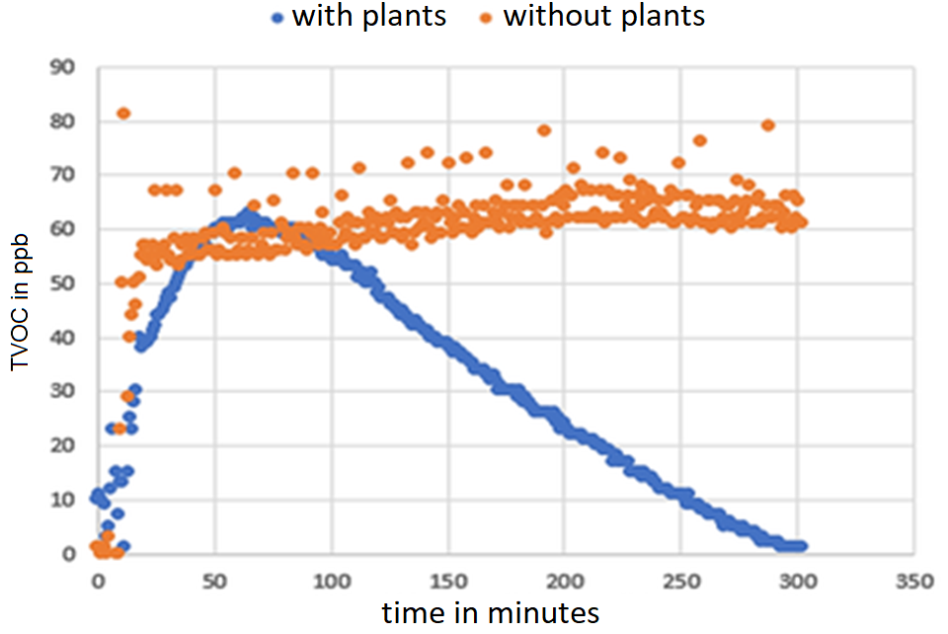
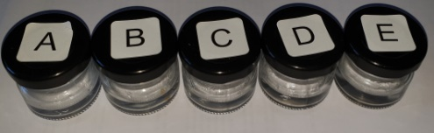
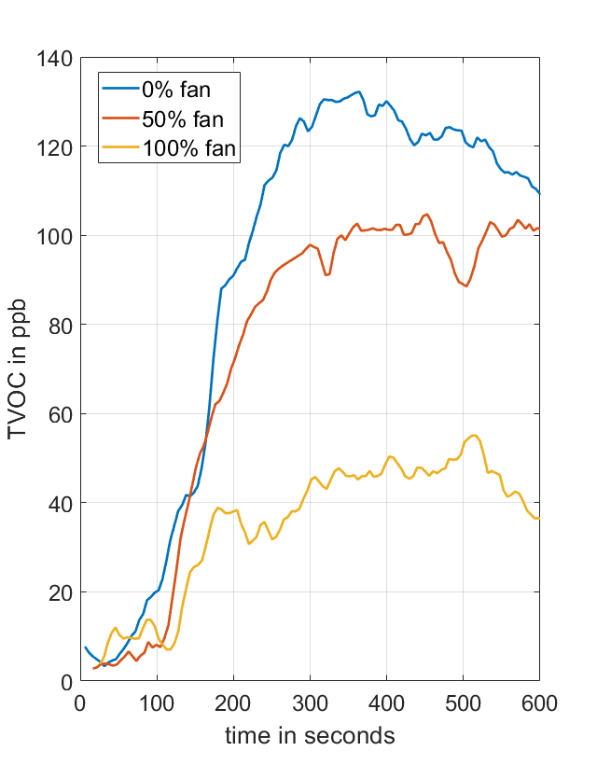
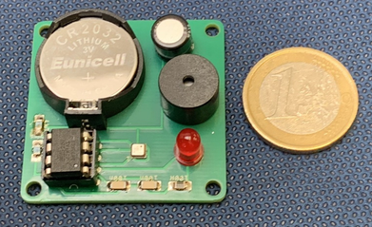


Citizen Science for high school students – Environmental studies with mobile devices
Sebastian Höfner, Prof. Dr. Andreas Schütze
Laboratory for Measurement Technology, Saarland University, Saarbrücken Germany
SUSmobil stands for „envirnmental studies by students with mobile measuring devices“ (German: „Schülerumweltstudien mit mobilen Messgeräten“) and aims to motivate high school students to design their own environmental questions and to answer them with professional help by scientists. Because students should not only act as data collectors, SUSmobil offers also to the opportunity to learn and understand the theoretical basics of gas detection technology „self learning courses“. This includes the functionality of a semiconductor gas sensor (module 1), the calibration process (module 2a) and the measurement of
indoor air quality (module 2b). The „Internet of Things“ (IoT) allows to record and store data on mobile devices and internet servers. The mobility and ubiquity of smartphones and tablets make it possible to experience a learning process that can take place seamlessly in a variety of scenarios and is not confined to the classroom or auditorium. Mobile technology acts as a mediator of such a learning process in the sense of the approach of "Mobile Assisted Seamless Learning".
Module 1
Functionality of a semiconductor gas sensor
Module 3
Pollution map
Structure of the module
The first module offers an introduction to the basics of semiconductor gas detection.
The students examine the sensor reaction in the presence of an atmosphere, that is saturated with water, alcohol free beer and apple juice. Depending on the sensor temperature, different processes on the surface of the sensor lead to a typical parabolic course of the sensor reaction.
Aim and implementation
As part of the youth research competition "Jugend forscht" a "Google Maps pollution map" was developed. With the aid of a 3D printed measuring chamber containing the BME680 sensor from Bosch, (uncalibrated) air quality measurements of the ambient air can be made. The data is sent together with GPS data to a server on the Internet and read by the app "Blynk". This makes it possible to display the data as a heat map via Google's Maps service.
Air compositon in bee hives
Aim
In cooperation with the regional association of beekeepers in Saarland, a "Jugend forscht" project was developed to examine beehives for gases, temperature, humidity and air pressure.
Students are given the opportunity to work scientifically in an authentic and current context by capturing, evaluating, and interpreting data.
Over a longer period of time (several months), measured data is sent to the online database service of "ThingSpeak“ by MathWorks and stored there. Then the data can be downloaded and analyzed.
After the recording of measurement series, the responsible processes are clearly described in a student-friendly model.
Module 2a
Calibration of semiconductor gas sensors
Structure of the module
The goal of this module is to calibrate a semiconductor gas sensor to different concentrations of ethanol. The sensor is located in a closed measuring chamber and is read out and controlled by a microcontroller.
Results
A comparison of the TVOC concentration with and without bees shows a periodic course in a 24 hour rhythm. The concentration within the beehive with bees is increased by about 800-1000 ppb. In addition, both curves are phase-shifted by approximately 12 hours.
By varying the ethanol concentration in the measuring chamber, "training data" can be recorded - a kind of fingerprint of the respective concentration. The data is collected using an intuitive measurement software that explains the concept of training data.
Bees have CO₂ sensors
The CO₂ concentration within the hive behaves analogously to the course of the TVOC concentration. In order to test whether bees regulate the CO₂ concentration actively by fanning, CO₂ was artificially increased. After a brief increase in concentration, the bees were able to regulate them to a value around 18,000 ppm. This behavior was evident at different flux densities.
Theoretical basics
Environmental studies
By introducing a "temperature cycled operation“ (tco), the sensitivity, selectivity and stability of the sensor can be improved.
In addition, emphasis is placed on the quantification of the sensor reactions by explaining the principle of feature extraction.
Influence of plants on air quality
Finally, the focus is also placed on modeling with the help of artificial intelligence. By means of illustrative examples it is shown how a neural network is able to learn and how it can be used to create a mathematical prediction model.
Aim
Two students investigated whether plants improve indoor air quality by absorbing or converting pollutants. For this purpose, two airtight measuring chambers equipped with gas sensors were built, one having plants in it and the second serving as a control box. Small amounts of ethanol, acetone, acetic acid and formic acid were added and their degradation examined.
Module 2b
Environmental measurements and indoor air quality qualitynenraumluftqualität
Structure of the module
The aim is to carry out environmental measurements in the interior. It introduces the environmentally relevant substances particulate matter, TVOC (Total Volatile Organic Compounds) and CO2, as an indicator of TVOC, as well as their health effects on human consumption is discussed.
Subsequently, official limits, possible sources and recommendations to avoid bad air quality are described. After all, the students get to know different sensor principles, like laser scattering and infrared absorption, and conduct their own measurements at four stations , focusing on different measurement variables.
Results
In the test the two sensors SGP30 of the company "Sensirion" and CCS811 of the company "ams" were used. In the evaluation, a significant decrease in the gas concentration was found in the comparison of the two measuring chambers, which, however, took different amounts of time depending on the type of pollutant. As an example, the course of the acetone concentration in the two measuring chambers, with (blue) or without (orange) plants to see.
Station 1 – Particulate Matter
Writing on and wiping a chalkboard produces high levels of particulate matter in the classroom. An effective way to reduce the fine dust is using wet sponges to clean the boards.
Station 2 – Human vs. Sensor
Many hazardous substances can not be perceived by the
Mobile carbon monoxide detector
human nose, or only in very high concentrations. Sensors, on the other hand, can detect these even in the smallest quantities and thus warn against dangers.
Aim
One student has been studying the measurement of carbon monoxide concentration in indoor air and the risks associated with the uptake of carbon monoxide (CO). As part of his project, a mobile carbon monoxide detector was developed
Station 3 – TVOC-duels
Paints, felt-tip pens, floor coverings or adhesives. Many products contain harmful substances.
Station 4 – Thick air
The most effective way to maintain good indoor air quality is to ventilate regularly.
But there are also environmental and health harmless alternatives.
Implementation
The CO detector uses the miniature gas sensor BME680 from Bosch. Controlled by a microcontroller, the LED is switched to a fast flashing mode when the CO concentration reaches more than 50 ppm. If the concentration reaches a threshold of 250 ppm, a warning signal is generated via a buzzer.
Sebastian Höfner
Lehrstuhl für Messtechnik
Abteilung Systems Engineering
Webseite: www.LMT.uni-saarland.de
Kontaktinformationen
Tel.: +49 681 302 – 2235
Fax: +49 681 302 – 4665
Mail: s.hoefner@lmt.uni-saarland.de
Projektwebseite: www.susmobil.de
Universität des Saarlandes
Campus A5.1 | Raum 2.29
66123 Saarbrücken

